Slide 1
Kshitij Sharam, Neerav Poriya, Priyanka Kadam, Tiffany Hatzidimitriu, Zo DiSanto
Notes:
[Introduce Ourselves + Bud]

Slide 2
Our Idea
MTA based navigation app
Priority to accessibility, including language
Different user needs for New New Yorkers and Native New Yorkers
Community enhanced data
Personalized alerts
Hard-coded maps (For underground travel)
Skill dependant directions
Notes:
(Neerav) There are some apps, like bank apps or medical apps, that we have to use whether we like it or not, because of that’s all that all we have. The apps works the way they works and you have to deal with it, well what if we break the chain!!!
Born from frustration towards current MTA navigation apps, CityBuddy is our new NYC MTA navigation app! Our app utilizes community enhanced data, alerts, hard-coded maps and skill dependant directions, for a more personalized and habituating travel experience.

Slide 3
Core Tasks
Traveling from location A to location B.
Notification of travel updates on saved routes
Community based navigation
Notes:
(Kshitij) We narrowed down our ideas into three core tasks: Traveling from location A to location B, Community based navigation and Notification of travel updates on saved routes
We felt these were the most important especially when thinking about our two user groups.

Slide 4
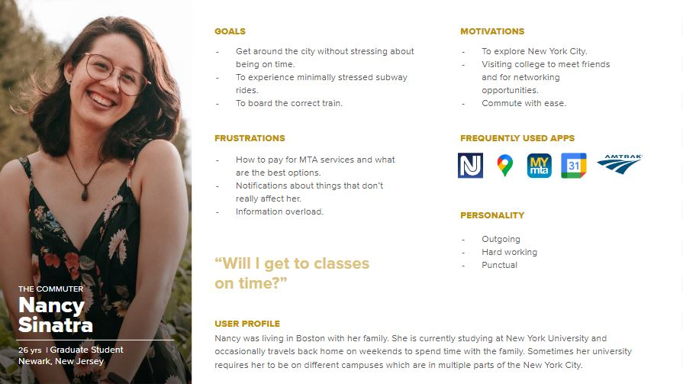
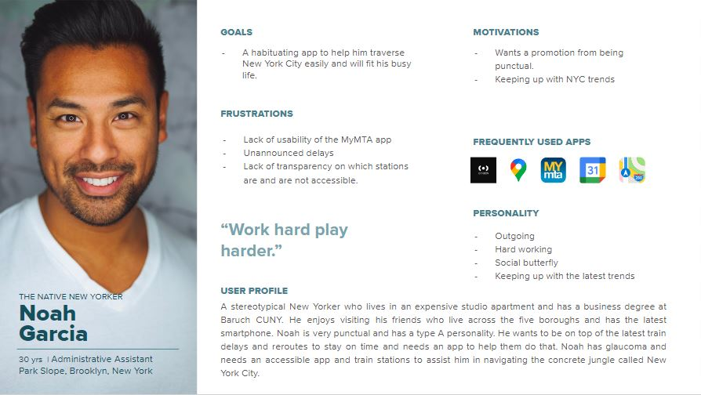
Personas
Notes:
(Neerav) Here are the personas for our two user groups:
Nancy is a new New Yorker. She’s not yet comfortable with the MTA transit system and wants to know what her fellow new yorkers are doing.
Noah is a native New Yorker. He knows the system and has his everyday route, but doesn’t have time to check his phone for delays or changes in their everyday route.

Slide 5
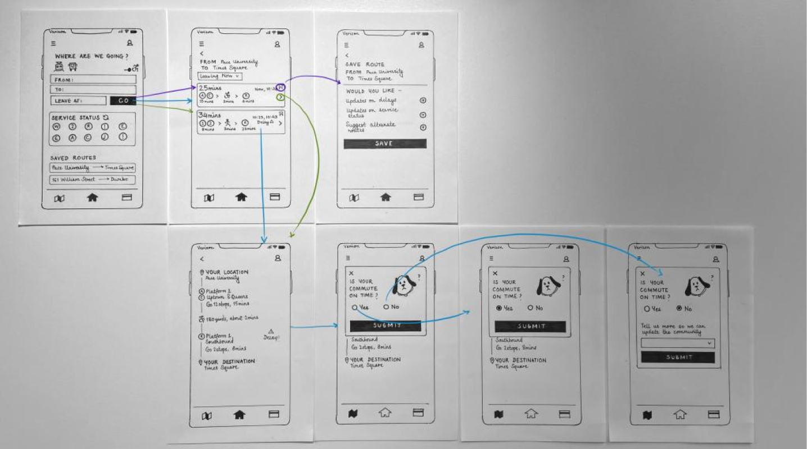
Paper Prototype
Notes:
(Priyanka) This is our paper prototype. We translated our core tasks into this paper version by making each core tasks a “widget” and/or pages. While navigating, our mascot Bud will pop up and inform you about community updates, and in this version we made the home tab the center since here are only three tabs.

Slide 6
Research - Paper Prototype
Users were unsatisfied with the location of saved routes on our home page
Nowhere to check community data unless you’re actively in a trip
Location of the “home” button isn’t familiar to users
Should be a page to see and edit saved routes
Finalize metrocard page and profile page
Notes:
(Zo) When we began research we made sure to ask native and new New Yorkers in order to get more holistic feedback that speaks to our two main user groups. Fortunately, most of our feedback was unanimous between user groups. For example, the location of the “home” button and the saved routes.

Slide 7
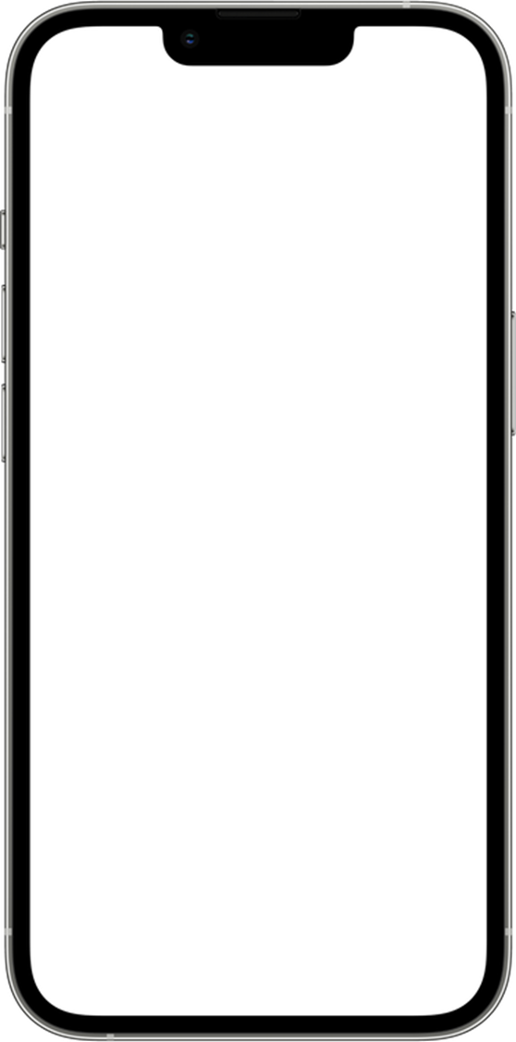
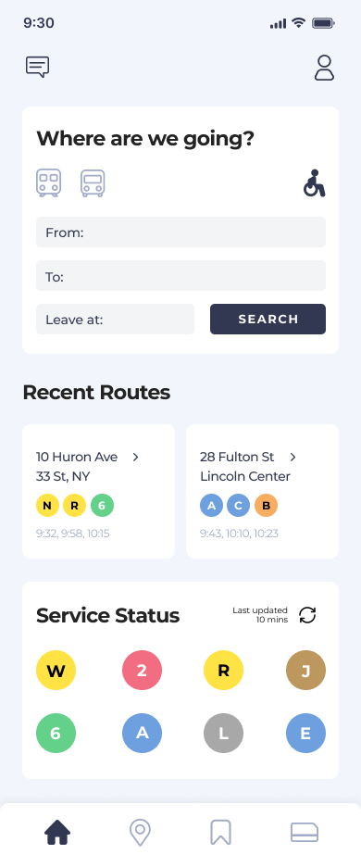
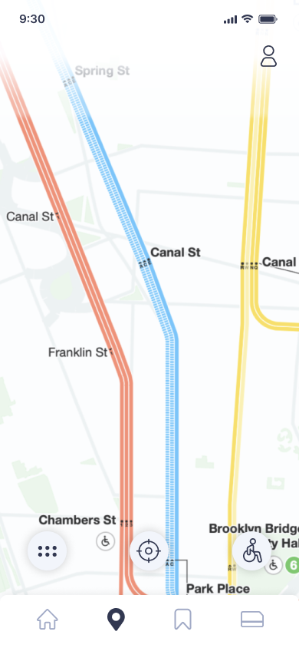
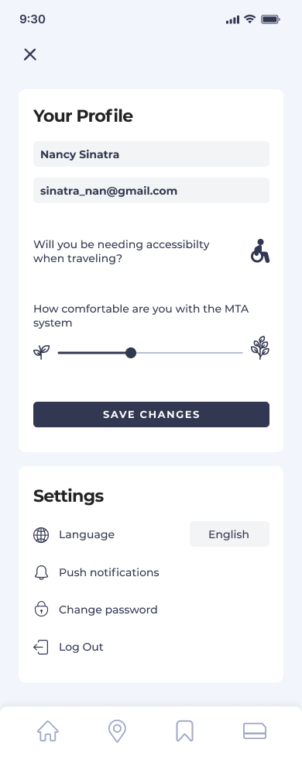
Figma Prototype
Notes:
(Priyanka) Here are some pages that were translated from the paper prototype. As you can see we moved the recent routes above service status, we finalized the map, which again is hard coded into the app so it can work underground when cellular service may be unavailable, and we created a profile page which includes a button for language settings, permanent accessibility requirements and a sliding function for comfortability with the NYC MTA system (sprout being not well versed and tree being expert).

Slide 8
Figma Prototype
Notes:
(Tiffany) These are some of the pages we added to our figma prototype that were not on the paper prototype. On the left, we put a general community tab in the top left corner, and on the right we have a metrocard page where you can see your recent transactions and add more money.

Slide 9
Figma Prototype Contd.
Notes:
(Tiffany) We also decided how to display our alerts in app represented on the left and on the right is what the saved routes page would look like.

Slide 10

Figma Prototype
Notes:
(Zo) Here is what our general flow would look like. We start by clicking the mode of transportation and the accessibility button if necessary. Then we type current and desired location as well as the time. Here we see how to save a route, all options are buttons that are organized by type of information, then we show deleting a saved route. Now when in a route, Bud might come out and inform you of new routes when he notices something may be going wrong in your current route. When in your new route, Bud asks you what happened and we used radio buttons instead of typed input for ease of use.

Slide 11
Research - Figma Prototype
Primary objective:
Can users successfully personalize their experience on the application?
Secondary objectives:
To determine how comfortably the user interacts with the application features
Traveling from location A to location B
Traveling from location A to location B with accessibility
Notes:
(Tiffany) For our research proposal on our Figma prototype we researched if users could successfully personalize their experience on our application. Our methodology of choice was a facilitated walkthrough where one designer asked predefined questions and one or two note takers recorded their responses. As with our paper prototype research we made sure to ask new and native New Yorkers as well as provide a scenario when accessible travel would be necessary.
We are fortunate to say that by the end of our research we discovered almost all of our participants across user groups would love to use this app!

Slide 12
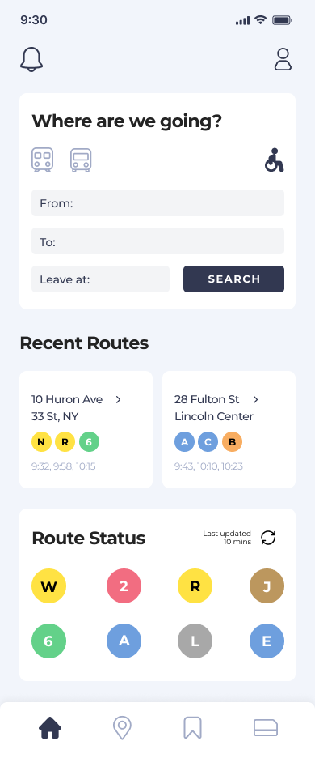
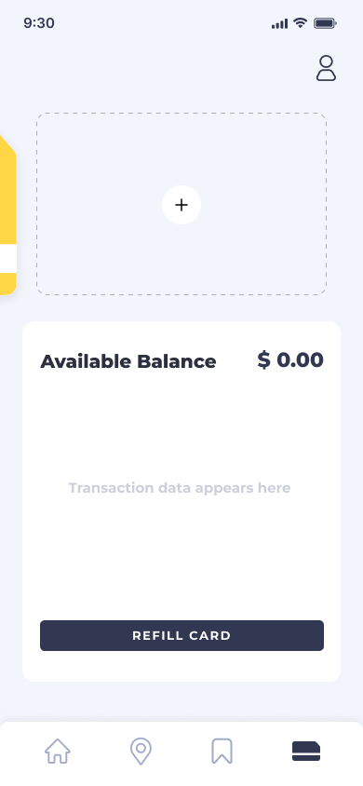
Results
Notes:
(Tiffany) We did make some changes though. The results of the research informed to us that we needed to make changes to accessibility, particularly the accessibility of our app to new New Yorkers. We decided to change some of the vocabulary like “Service Status” to “Route Status” as well as icon changes to our community tab to a bell icon.
We also added the option to add other kinds of cards to the card page since multiple users, native and non native, expressed an interest in a tap-to-pay function within the app.
Moving forward changes can be made to the community feedback feature with the analytics collected from long term use as well as adjusting the navigation directions given to ‘sprouts’ vs ‘trees’. And of course any transitions necessary from wireframe to working prototype.

Slide 13
Q&A
Thank you!

